Slide 1

Reasoning About Group Polarization: From Semantic Games to Sequent Systems
📷 Tanner Mardis
Robert Freiman
Carlos Olarte
Elaine Pimentel
Chris Fehrmüller

Slide 2
Semantic Game (truth in a model)
lift
Provability Game
(validity)
extract
Analytic Calculus
Notes:
Unkonventionelle Struktur explizit
Let me start unconventionally, later talk about overview

Slide 3
Hintikka‘s Semantic Game
$$a^{+}$$
$$b^{+}$$
$$c^{+}$$
$$⋮$$
$$a^{−}$$
$$b^{−}$$
$$c^{−}$$

Slide 4


Hintikka‘s Semantic Game
Formula $F=\left[a^{−}∨\left(b^{+}∧c^{−}\right)\right]∨\left[a^{+}∧b^{−}\right]$
Model $ℐ=\left\{a^{+},b^{−},c^{−}\right\}$
$$a^{+}$$
$$b^{+}$$
$$c^{+}$$
$$⋮$$
$$a^{−}$$
$$b^{−}$$
$$c^{−}$$
$F$ is true over $ℐ$!
$F$ is false over $ℐ$!
Proponent
Opponent
Notes:
Negation durch Role Switch erwähnen, aber nicht betrachtet (verbal)

Slide 5
Hintikka‘s Semantic Game
$$a^{+}$$
$$b^{+}$$
$$c^{+}$$
$$a^{−}$$
$$b^{−}$$
$$c^{−}$$
Formula $F=\left[a^{−}∨\left(b^{+}∧c^{−}\right)\right]∨\left[a^{+}∧b^{−}\right]$
Model $ℐ=\left\{a^{+},b^{−},c^{−}\right\}$
$∨$
$∧$
$a^{±}$
$a^{±}$
at $F_{1}∨F_{2}$, P chooses between $F_{1}$ and $F_{2}$
at $F_{1}∧F_{2}$, O chooses between $F_{1}$ and $F_{2}$
at $a^{±}$,
P wins iff $ℐ⊨a^{±}$
at $p^{±}$,
O wins iff $ℐ⊭a^{±}$
$F$ is true over $ℐ$!
$F$ is false over $ℐ$!
Notes:
Formel animation löschen

Slide 6
Example
$$a^{+}$$
$$b^{+}$$
$$c^{+}$$
$$a^{−}$$
$$b^{−}$$
$$c^{−}$$
Formula $F=\left[a^{−}∨\left(b^{+}∧c^{−}\right)\right]∨\left[a^{+}∧b^{−}\right]$
Model $ℐ=\left\{a^{+},b^{−},c^{−}\right\}$
$∨$
$\left[a^{−}∨\left(b^{+}∧c^{−}\right)\right]∨\left[a^{+}∧b^{−}\right]$
P chooses
$∧$
O chooses
$a^{−}∨\left(b^{+}∧c^{−}\right)$
$a^{+}∧b^{−}$
$a^{±}$
P wins iff $ℐ⊨p^{±}$
$a^{−}$
$b^{+}∧c^{−}$
$a^{+}$
$b^{−}$
O wins iff $ℐ⊭a^{±}$
$b^{+}$
$c^{−}$
$a^{±}$
Notes:
animation formel löschen (auch nächste Slides?)

Slide 7
Example
$$a^{+}$$
$$b^{+}$$
$$c^{+}$$
$$a^{−}$$
$$b^{−}$$
$$c^{−}$$
Formula $F=\left[a^{−}∨\left(b^{+}∧c^{−}\right)\right]∨\left[a^{+}∧\left(b^{−}∨c^{+}\right)\right]$
Model $ℐ=\left\{a^{+},b^{−},c^{−}\right\}$
P has a winning strategy:
$∨$
$\left[a^{−}∨\left(b^{+}∧c^{−}\right)\right]∨\left[a^{+}∧b^{−}\right]$
P chooses
$∧$
O chooses
$a^{−}∨\left(b^{+}∧c^{−}\right)$
$a^{+}∧b^{−}$
$a^{±}$
P wins iff $ℐ⊨p^{±}$
$a^{−}$
$b^{+}∧c^{−}$
$a^{+}$
$b^{−}$
O wins iff $ℐ⊭a^{±}$
$b^{+}$
$c^{−}$
$a^{±}$
Notes:
falsche Formel
dicke Striche

Slide 8
Example
$$a^{+}$$
$$b^{+}$$
$$c^{+}$$
$$a^{−}$$
$$b^{−}$$
$$c^{−}$$
Formula $F=\left[a^{−}∨\left(b^{+}∧c^{−}\right)\right]∨\left[a^{+}∧\left(b^{−}∨c^{+}\right)\right]$
Model $ℐ=\left\{a^{+},b^{−},c^{−}\right\}$
P has a winning strategy:
$∨$
$\left[a^{−}∨\left(b^{+}∧c^{−}\right)\right]∨\left[a^{+}∧b^{−}\right]$
P chooses
$∧$
O chooses
$a^{+}∧b^{−}$
$a^{±}$
P wins iff $ℐ⊨p^{±}$
$a^{+}$
$b^{−}$
$a^{±}$
O wins iff $ℐ⊭a^{±}$
P has a winning strategy in $S_{ℐ}^{CL}\left(F\right)$ iff $ℐ⊨F$.
Notes:
Two times theorem box?

Slide 9
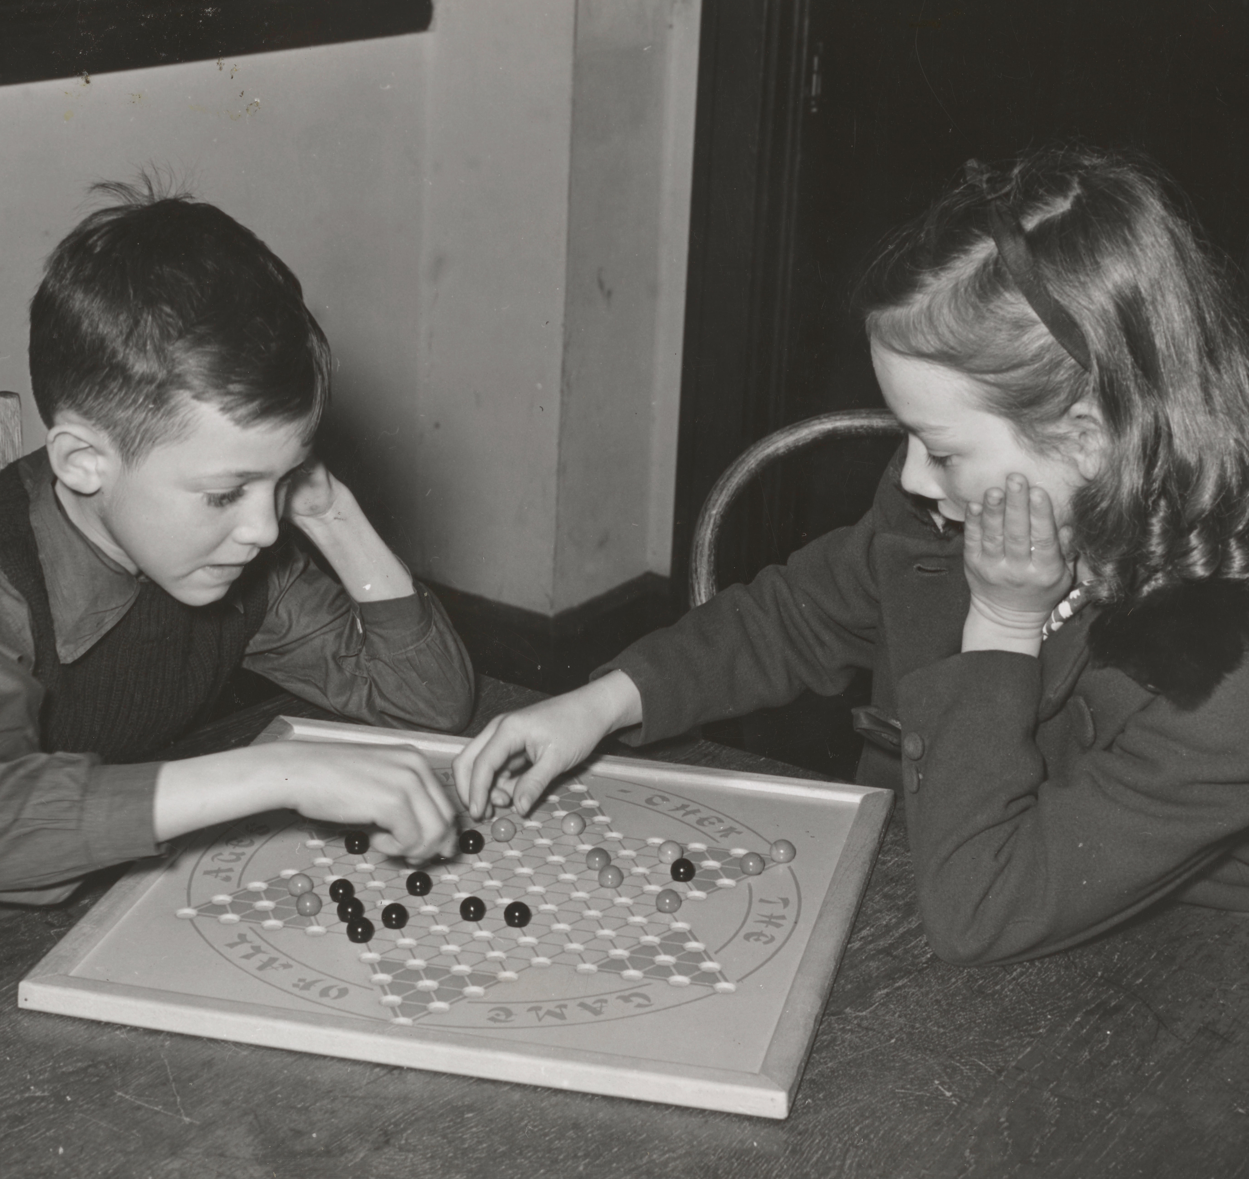
From Semantic Games to Provability Games
Can P play the game such that she wins in every model?
📷The New York Public Library
Notes:
Selbe Font in der Überschrift

Slide 10
Uniform Strategies?
Can P play the game such that she wins in every model?
$\left[a^{−}∨\left(b^{+}∧c^{−}\right)\right]∨\left[a^{+}∧\left(b^{−}∨c^{+}\right)\right]$
$\left[a^{−}∨\left(b^{+}∧c^{−}\right)\right]∨\left[a^{+}∧\left(b^{−}∨c^{+}\right)\right]$
$\left[a^{−}∨\left(b^{+}∧c^{−}\right)\right]∨\left[a^{+}∧\left(b^{−}∨c^{+}\right)\right]$
$\left[a^{−}∨\left(b^{+}∧c^{−}\right)\right]∨\left[a^{+}∧\left(b^{−}∨c^{+}\right)\right]$
$\left[a^{−}∨\left(b^{+}∧c^{−}\right)\right]∨\left[a^{+}∧\left(b^{−}∨c^{+}\right)\right]$
$a^{+}∧\left(b^{−}∨c^{+}\right)$
$a^{+}∧\left(b^{−}∨c^{+}\right)$
$a^{+}∧\left(b^{−}∨c^{+}\right)$
$a^{+}∧\left(b^{−}∨c^{+}\right)$
$a^{−}∨\left(b^{+}∧c^{−}\right)$
$a^{+}∧\left(b^{−}∨c^{+}\right)$
$a^{−}∨\left(b^{+}∧c^{−}\right)$
$a^{−}∨\left(b^{+}∧c^{−}\right)$
$a^{−}∨\left(b^{+}∧c^{−}\right)$
$a^{−}∨\left(b^{+}∧c^{−}\right)$
$b^{+}∧c^{−}$
$b^{+}∧c^{−}$
$b^{+}∧c^{−}$
$b^{+}∧c^{−}$
$b^{+}∧c^{−}$
$a^{+}$
$a^{+}$
$a^{+}$
$a^{+}$
$a^{−}$
$a^{+}$
$a^{−}$
$a^{−}$
$a^{−}$
$a^{−}$
$$b^{−}∨c^{+}$$
$$b^{−}∨c^{+}$$
$$b^{−}∨c^{+}$$
$$b^{−}∨c^{+}$$
$$b^{−}∨c^{+}$$
$b^{+}$
$b^{+}$
$b^{+}$
$b^{+}$
$b^{+}$
$c^{−}$
$c^{−}$
$c^{−}$
$c^{−}$
$c^{−}$
$b^{−}$
$b^{−}$
$b^{−}$
$b^{−}$
$b^{−}$
$c^{+}$
$c^{+}$
$c^{+}$
$c^{+}$
$c^{+}$

Slide 11
Uniform Strategies?
$\left[a^{−}∨\left(b^{+}∧c^{−}\right)\right]∨\left[a^{+}∧\left(b^{−}∨c^{+}\right)\right]$
$a^{−}∨\left(b^{+}∧c^{−}\right)$
$a^{+}∧\left(b^{−}∨c^{+}\right)$
$a^{−}$
$b^{+}∧c^{−}$
$a^{+}$
$$b^{−}∨c^{+}$$
$b^{+}$
$c^{−}$
$b^{−}$
$c^{+}$
$\left[a^{−}∨\left(b^{+}∧c^{−}\right)\right]∨\left[a^{+}∧\left(b^{−}∨c^{+}\right)\right]$
$\left[a^{−}∨\left(b^{+}∧c^{−}\right)\right]∨\left[a^{+}∧\left(b^{−}∨c^{+}\right)\right]$
$a^{−}∨\left(b^{+}∧c^{−}\right)$
$a^{+}∧\left(b^{−}∨c^{+}\right)$
$a^{−}$
$b^{+}∧c^{−}$
$a^{+}$
$$b^{−}∨c^{+}$$
$a^{−}∨\left(b^{+}∧c^{−}\right)$
$a^{+}∧\left(b^{−}∨c^{+}\right)$
$b^{+}$
$c^{−}$
$b^{−}$
$c^{+}$
$\left[a^{−}∨\left(b^{+}∧c^{−}\right)\right]∨\left[a^{+}∧\left(b^{−}∨c^{+}\right)\right]$
$a^{−}$
$b^{+}∧c^{−}$
$a^{+}$
$$b^{−}∨c^{+}$$
$a^{−}∨\left(b^{+}∧c^{−}\right)$
$a^{+}∧\left(b^{−}∨c^{+}\right)$
$a^{−}$
$b^{+}∧c^{−}$
$a^{+}$
$$b^{−}∨c^{+}$$
$b^{+}$
$c^{−}$
$b^{+}$
$c^{−}$
$b^{−}$
$c^{+}$
$b^{−}$
$c^{+}$
$\left[a^{−}∨\left(b^{+}∧c^{−}\right)\right]∨\left[a^{+}∧\left(b^{−}∨c^{+}\right)\right]$
$a^{−}∨\left(b^{+}∧c^{−}\right)$
$a^{+}∧\left(b^{−}∨c^{+}\right)$
$a^{−}$
$b^{+}∧c^{−}$
$a^{+}$
$$b^{−}∨c^{+}$$
$b^{+}$
$c^{−}$
$b^{−}$
$c^{+}$

Slide 12
Uniform Strategies?
$\left[a^{−}∨\left(b^{+}∧c^{−}\right)\right]∨\left[a^{+}∧\left(b^{−}∨c^{+}\right)\right]$
$a^{−}∨\left(b^{+}∧c^{−}\right)$
$a^{−}$
$\left[a^{−}∨\left(b^{+}∧c^{−}\right)\right]∨\left[a^{+}∧\left(b^{−}∨c^{+}\right)\right]$
$\left[a^{−}∨\left(b^{+}∧c^{−}\right)\right]∨\left[a^{+}∧\left(b^{−}∨c^{+}\right)\right]$
$a^{−}∨\left(b^{+}∧c^{−}\right)$
$b^{+}∧c^{−}$
$a^{−}∨\left(b^{+}∧c^{−}\right)$
$a^{+}∧\left(b^{−}∨c^{+}\right)$
$b^{+}$
$c^{−}$
$\left[a^{−}∨\left(b^{+}∧c^{−}\right)\right]∨\left[a^{+}∧\left(b^{−}∨c^{+}\right)\right]$
$a^{−}$
$b^{+}∧c^{−}$
$a^{+}$
$$b^{−}∨c^{+}$$
$a^{+}∧\left(b^{−}∨c^{+}\right)$
$a^{+}$
$$b^{−}∨c^{+}$$
$b^{+}$
$c^{−}$
$b^{−}$
$c^{+}$
$b^{−}$
$\left[a^{−}∨\left(b^{+}∧c^{−}\right)\right]∨\left[a^{+}∧\left(b^{−}∨c^{+}\right)\right]$
$a^{+}∧\left(b^{−}∨c^{+}\right)$
$a^{+}$
$$b^{−}∨c^{+}$$
$c^{+}$

Slide 13
Uniform Strategies?
$\left[a^{−}∨\left(b^{+}∧c^{−}\right)\right]∨\left[a^{+}∧\left(b^{−}∨c^{+}\right)\right]$
not winning for $ℐ=\left\{a^{+},b^{+},c^{+}\right\}$
$a^{−}∨\left(b^{+}∧c^{−}\right)$
$a^{−}$
$\left[a^{−}∨\left(b^{+}∧c^{−}\right)\right]∨\left[a^{+}∧\left(b^{−}∨c^{+}\right)\right]$
$\left[a^{−}∨\left(b^{+}∧c^{−}\right)\right]∨\left[a^{+}∧\left(b^{−}∨c^{+}\right)\right]$
$a^{−}∨\left(b^{+}∧c^{−}\right)$
not winning for $ℐ=\left\{a^{+},b^{+},c^{+}\right\}$
$b^{+}∧c^{−}$
$a^{−}∨\left(b^{+}∧c^{−}\right)$
$a^{+}∧\left(b^{−}∨c^{+}\right)$
$b^{+}$
$c^{−}$
$\left[a^{−}∨\left(b^{+}∧c^{−}\right)\right]∨\left[a^{+}∧\left(b^{−}∨c^{+}\right)\right]$
$a^{−}$
$b^{+}∧c^{−}$
$a^{+}$
$$b^{−}∨c^{+}$$
$a^{+}∧\left(b^{−}∨c^{+}\right)$
not winning for $ℐ=\left\{a^{−},b^{+},c^{+}\right\}$
$a^{+}$
$$b^{−}∨c^{+}$$
$b^{+}$
$c^{−}$
$b^{−}$
$c^{+}$
$b^{−}$
$\left[a^{−}∨\left(b^{+}∧c^{−}\right)\right]∨\left[a^{+}∧\left(b^{−}∨c^{+}\right)\right]$
$a^{+}∧\left(b^{−}∨c^{+}\right)$
not winning for $ℐ=\left\{a^{−},b^{+},c^{+}\right\}$
$a^{+}$
$$b^{−}∨c^{+}$$
$c^{+}$

Slide 14
The Provability Game
Formula $F=\left[a^{−}∨\left(b^{+}∧c^{−}\right)\right]∨\left[a^{+}∧\left(b^{−}∨c^{+}\right)\right]$
$∨$
P chooses
$B$
P can create backup copies: at $F$, continue with $F∥F$
$∧$
O chooses
P wins in $a^{±}$ iff for every model $ℐ$, $ℐ⊨a^{±}$
$a^{±}$
$a^{±}$
O wins otherwise

Slide 15
The Provability Game
Formula $F=\left[a^{−}∨\left(b^{+}∧c^{−}\right)\right]∨\left[a^{+}∧\left(b^{−}∨c^{+}\right)\right]$
$∨$
P chooses
P can create backup copies: at $F_{1}∥…∥F_{i}∥…∥F_{n}$, continue with
$F_{1}∥…∥F_{i}∥F_{i}∥…∥F_{n}$
$B$
$∧$
O chooses
P wins in $a_{1}^{±}∥…∥a_{n}^{±}$ iff for every model $ℐ$, there is some $i$ with $ℐ⊨a_{i}^{±}$
$Win$
$S$
P is the scheduler
$Win$
O wins otherwise

Slide 16
Example
$\left[a^{−}∨\left(b^{+}∧c^{−}\right)\right]∨\left[a^{+}∧\left(b^{−}∨c^{+}\right)\right]$

Slide 17
Example
$\left[a^{−}∨\left(b^{+}∧c^{−}\right)\right]∨\left[a^{+}∧\left(b^{−}∨c^{+}\right)\right]$
$$\left[a^{−}∨\left(b^{+}∧c^{−}\right)\right]∨\left[a^{+}∧\left(b^{−}∨c^{+}\right)\right]∥\left[a^{−}∨\left(b^{+}∧c^{−}\right)\right]∨\left[a^{+}∧\left(b^{−}∨c^{+}\right)\right]$$

Slide 18
Example
$\left[a^{−}∨\left(b^{+}∧c^{−}\right)\right]∨\left[a^{+}∧\left(b^{−}∨c^{+}\right)\right]$
$$\overline{\left[a^{−}∨\left(b^{+}∧c^{−}\right)\right]∨\left[a^{+}∧\left(b^{−}∨c^{+}\right)\right]}∥\left[a^{−}∨\left(b^{+}∧c^{−}\right)\right]∨\left[a^{+}∧\left(b^{−}∨c^{+}\right)\right]$$
Notes:
Überschriften Größe gleich

Slide 19
Example
$\left[a^{−}∨\left(b^{+}∧c^{−}\right)\right]∨\left[a^{+}∧\left(b^{−}∨c^{+}\right)\right]$
$$\overline{\left[a^{−}∨\left(b^{+}∧c^{−}\right)\right]∨\left[a^{+}∧\left(b^{−}∨c^{+}\right)\right]}∥\left[a^{−}∨\left(b^{+}∧c^{−}\right)\right]∨\left[a^{+}∧\left(b^{−}∨c^{+}\right)\right]$$
$$a^{−}∨\left(b^{+}∧c^{−}\right)∥\left[a^{−}∨\left(b^{+}∧c^{−}\right)\right]∨\left[a^{+}∧\left(b^{−}∨c^{+}\right)\right]$$

Slide 20
Example
$\left[a^{−}∨\left(b^{+}∧c^{−}\right)\right]∨\left[a^{+}∧\left(b^{−}∨c^{+}\right)\right]$
$$\overline{\left[a^{−}∨\left(b^{+}∧c^{−}\right)\right]∨\left[a^{+}∧\left(b^{−}∨c^{+}\right)\right]}∥\left[a^{−}∨\left(b^{+}∧c^{−}\right)\right]∨\left[a^{+}∧\left(b^{−}∨c^{+}\right)\right]$$
$$a^{−}∨\left(b^{+}∧c^{−}\right)∥\overline{\left[a^{−}∨\left(b^{+}∧c^{−}\right)\right]∨\left[a^{+}∧\left(b^{−}∨c^{+}\right)\right]}$$

Slide 21
Example
$\left[a^{−}∨\left(b^{+}∧c^{−}\right)\right]∨\left[a^{+}∧\left(b^{−}∨c^{+}\right)\right]$
$$\overline{\left[a^{−}∨\left(b^{+}∧c^{−}\right)\right]∨\left[a^{+}∧\left(b^{−}∨c^{+}\right)\right]}∥\left[a^{−}∨\left(b^{+}∧c^{−}\right)\right]∨\left[a^{+}∧\left(b^{−}∨c^{+}\right)\right]$$
$$a^{−}∨\left(b^{+}∧c^{−}\right)∥\overline{\left[a^{−}∨\left(b^{+}∧c^{−}\right)\right]∨\left[a^{+}∧\left(b^{−}∨c^{+}\right)\right]}$$
$$a^{−}∨\left(b^{+}∧c^{−}\right)∥\overline{a^{+}∧\left(b^{−}∨c^{+}\right)}$$

Slide 22
Example
$\left[a^{−}∨\left(b^{+}∧c^{−}\right)\right]∨\left[a^{+}∧\left(b^{−}∨c^{+}\right)\right]$
$$\overline{\left[a^{−}∨\left(b^{+}∧c^{−}\right)\right]∨\left[a^{+}∧\left(b^{−}∨c^{+}\right)\right]}∥\left[a^{−}∨\left(b^{+}∧c^{−}\right)\right]∨\left[a^{+}∧\left(b^{−}∨c^{+}\right)\right]$$
$$a^{−}∨\left(b^{+}∧c^{−}\right)∥\overline{\left[a^{−}∨\left(b^{+}∧c^{−}\right)\right]∨\left[a^{+}∧\left(b^{−}∨c^{+}\right)\right]}$$
$$a^{−}∨\left(b^{+}∧c^{−}\right)∥\overline{a^{+}∧\left(b^{−}∨c^{+}\right)}$$
$$\overline{a^{−}∨\left(b^{+}∧c^{−}\right)}∥a^{+}$$
$$\overline{a^{−}∨\left(b^{+}∧c^{−}\right)}∥b^{−}∨c^{+}$$

Slide 23
Example
$\left[a^{−}∨\left(b^{+}∧c^{−}\right)\right]∨\left[a^{+}∧\left(b^{−}∨c^{+}\right)\right]$
$$\overline{\left[a^{−}∨\left(b^{+}∧c^{−}\right)\right]∨\left[a^{+}∧\left(b^{−}∨c^{+}\right)\right]}∥\left[a^{−}∨\left(b^{+}∧c^{−}\right)\right]∨\left[a^{+}∧\left(b^{−}∨c^{+}\right)\right]$$
$$a^{−}∨\left(b^{+}∧c^{−}\right)∥\overline{\left[a^{−}∨\left(b^{+}∧c^{−}\right)\right]∨\left[a^{+}∧\left(b^{−}∨c^{+}\right)\right]}$$
$$a^{−}∨\left(b^{+}∧c^{−}\right)∥\overline{a^{+}∧\left(b^{−}∨c^{+}\right)}$$
$$\overline{a^{−}∨\left(b^{+}∧c^{−}\right)}∥a^{+}$$
$$\overline{a^{−}∨\left(b^{+}∧c^{−}\right)}∥b^{−}∨c^{+}$$
$$a^{−}∥a^{+}$$

Slide 24
Example
$\left[a^{−}∨\left(b^{+}∧c^{−}\right)\right]∨\left[a^{+}∧\left(b^{−}∨c^{+}\right)\right]$
$$\overline{\left[a^{−}∨\left(b^{+}∧c^{−}\right)\right]∨\left[a^{+}∧\left(b^{−}∨c^{+}\right)\right]}∥\left[a^{−}∨\left(b^{+}∧c^{−}\right)\right]∨\left[a^{+}∧\left(b^{−}∨c^{+}\right)\right]$$
$$a^{−}∨\left(b^{+}∧c^{−}\right)∥\overline{\left[a^{−}∨\left(b^{+}∧c^{−}\right)\right]∨\left[a^{+}∧\left(b^{−}∨c^{+}\right)\right]}$$
$$a^{−}∨\left(b^{+}∧c^{−}\right)∥\overline{a^{+}∧\left(b^{−}∨c^{+}\right)}$$
$$\overline{a^{−}∨\left(b^{+}∧c^{−}\right)}∥a^{+}$$
$$\overline{a^{−}∨\left(b^{+}∧c^{−}\right)}∥b^{−}∨c^{+}$$
$$a^{−}∥a^{+}$$
$$\overline{b^{+}∧c^{−}}∥b^{−}∨c^{+}$$

Slide 25
Example
$\left[a^{−}∨\left(b^{+}∧c^{−}\right)\right]∨\left[a^{+}∧\left(b^{−}∨c^{+}\right)\right]$
$$\overline{\left[a^{−}∨\left(b^{+}∧c^{−}\right)\right]∨\left[a^{+}∧\left(b^{−}∨c^{+}\right)\right]}∥\left[a^{−}∨\left(b^{+}∧c^{−}\right)\right]∨\left[a^{+}∧\left(b^{−}∨c^{+}\right)\right]$$
$$a^{−}∨\left(b^{+}∧c^{−}\right)∥\overline{\left[a^{−}∨\left(b^{+}∧c^{−}\right)\right]∨\left[a^{+}∧\left(b^{−}∨c^{+}\right)\right]}$$
$$a^{−}∨\left(b^{+}∧c^{−}\right)∥\overline{a^{+}∧\left(b^{−}∨c^{+}\right)}$$
$$\overline{a^{−}∨\left(b^{+}∧c^{−}\right)}∥a^{+}$$
$$\overline{a^{−}∨\left(b^{+}∧c^{−}\right)}∥b^{−}∨c^{+}$$
$$a^{−}∥a^{+}$$
$$\overline{b^{+}∧c^{−}}∥b^{−}∨c^{+}$$
$$b^{+}∥\overline{b^{−}∨c^{+}}$$
$$c^{−}∥\overline{b^{−}∨c^{+}}$$

Slide 26
Example
$\left[a^{−}∨\left(b^{+}∧c^{−}\right)\right]∨\left[a^{+}∧\left(b^{−}∨c^{+}\right)\right]$
$$\overline{\left[a^{−}∨\left(b^{+}∧c^{−}\right)\right]∨\left[a^{+}∧\left(b^{−}∨c^{+}\right)\right]}∥\left[a^{−}∨\left(b^{+}∧c^{−}\right)\right]∨\left[a^{+}∧\left(b^{−}∨c^{+}\right)\right]$$
$$a^{−}∨\left(b^{+}∧c^{−}\right)∥\overline{\left[a^{−}∨\left(b^{+}∧c^{−}\right)\right]∨\left[a^{+}∧\left(b^{−}∨c^{+}\right)\right]}$$
$$a^{−}∨\left(b^{+}∧c^{−}\right)∥\overline{a^{+}∧\left(b^{−}∨c^{+}\right)}$$
$$\overline{a^{−}∨\left(b^{+}∧c^{−}\right)}∥a^{+}$$
$$\overline{a^{−}∨\left(b^{+}∧c^{−}\right)}∥b^{−}∨c^{+}$$
$$a^{−}∥a^{+}$$
$$\overline{b^{+}∧c^{−}}∥b^{−}∨c^{+}$$
$$b^{+}∥\overline{b^{−}∨c^{+}}$$
$$c^{−}∥\overline{b^{−}∨c^{+}}$$
$$b^{+}∥b^{−}$$

Slide 27
Example
$\left[a^{−}∨\left(b^{+}∧c^{−}\right)\right]∨\left[a^{+}∧\left(b^{−}∨c^{+}\right)\right]$
$$\overline{\left[a^{−}∨\left(b^{+}∧c^{−}\right)\right]∨\left[a^{+}∧\left(b^{−}∨c^{+}\right)\right]}∥\left[a^{−}∨\left(b^{+}∧c^{−}\right)\right]∨\left[a^{+}∧\left(b^{−}∨c^{+}\right)\right]$$
$$a^{−}∨\left(b^{+}∧c^{−}\right)∥\overline{\left[a^{−}∨\left(b^{+}∧c^{−}\right)\right]∨\left[a^{+}∧\left(b^{−}∨c^{+}\right)\right]}$$
$$a^{−}∨\left(b^{+}∧c^{−}\right)∥\overline{a^{+}∧\left(b^{−}∨c^{+}\right)}$$
$$\overline{a^{−}∨\left(b^{+}∧c^{−}\right)}∥a^{+}$$
$$\overline{a^{−}∨\left(b^{+}∧c^{−}\right)}∥b^{−}∨c^{+}$$
$$a^{−}∥a^{+}$$
$$\overline{b^{+}∧c^{−}}∥b^{−}∨c^{+}$$
$$b^{+}∥\overline{b^{−}∨c^{+}}$$
$$c^{−}∥\overline{b^{−}∨c^{+}}$$
$$b^{+}∥b^{−}$$
$$c^{−}∥c^{+}$$

Slide 28
Adequacy
P has wss in $S_{ℐ}\left(F\right)$ for all $ℐ$
P has a ws in $P\left(F\right)$

Slide 29
Adequacy
P has wss in $S_{ℐ}\left(φ\right)$ for all $ℐ$
O has a ws in $S_{ℐ}\left(φ\right)$ for some $ℐ$
extract
extract
P has a ws in $P\left(φ\right)$
O has a ws in $P\left(φ\right)$

Slide 30
Example (of a proof)
$$b^{+}∥b^{−}$$
$$c^{−}∥c^{+}$$
$$b^{+}∥\overline{b^{−}∨c^{+}}$$
$$c^{−}∥\overline{b^{−}∨c^{+}}$$
$$a^{−}∥a^{+}$$
$$\overline{b^{+}∧c^{−}}∥b^{−}∨c^{+}$$
$$\overline{a^{−}∨\left(b^{+}∧c^{−}\right)}∥a^{+}$$
$$\overline{a^{−}∨\left(b^{+}∧c^{−}\right)}∥b^{−}∨c^{+}$$
$$a^{−}∨\left(b^{+}∧c^{−}\right)∥\overline{a^{+}∧\left(b^{−}∨c^{+}\right)}$$
$$a^{−}∨\left(b^{+}∧c^{−}\right)∥\overline{\left[a^{−}∨\left(b^{+}∧c^{−}\right)\right]∨\left[a^{+}∧\left(b^{−}∨c^{+}\right)\right]}$$
$$\overline{\left[a^{−}∨\left(b^{+}∧c^{−}\right)\right]∨\left[a^{+}∧\left(b^{−}∨c^{+}\right)\right]}∥\left[a^{−}∨\left(b^{+}∧c^{−}\right)\right]∨\left[a^{+}∧\left(b^{−}∨c^{+}\right)\right]$$
$$\left[a^{−}∨\left(b^{+}∧c^{−}\right)\right]∨\left[a^{+}∧\left(b^{−}∨c^{+}\right)\right]$$

Slide 31
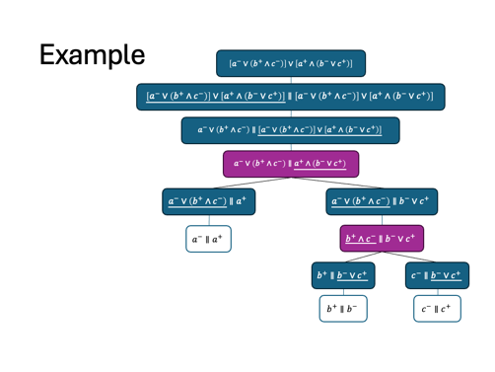
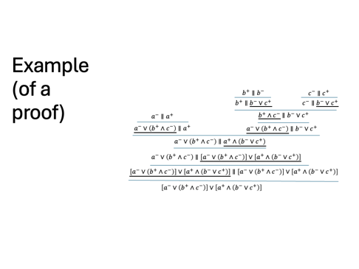
From Provability Games to Proofs
Notes:
Example schaut rüber

Slide 32
Proof Theory
$∨$
$∧$
$B$
$Win$
at $F_{1}∨F_{2}$, P chooses between $F_{1}$ and $F_{2}$
at $F_{1}∧F_{2}$, O chooses between $F_{1}$ and $F_{2}$
P can create backup copies: at $𝒟∥F$, continue with
$𝒟∥F∥F$
P wins in $a_{1}^{±}∥…∥a_{n}^{±}∥b^{+}∥b^{−}$
$$\frac{𝒟∥F_{1}}{𝒟∥F_{1}∨F_{2}}{\left(∨\right)}_{1}$$
$$\frac{\begin{matrix}𝒟∥F_{1} & 𝒟∥F_{2}\end{matrix}}{𝒟∥F_{1}∧F_{2}}\left(∧\right)$$
$$\frac{𝒟∥F∥F}{𝒟∥F}\left(c\right)$$
$a_{1}^{±}∥…∥a_{n}^{±}∥b^{+}∥b^{−}$ (Axiom)
$$\frac{𝒟∥F_{2}}{𝒟∥F_{1}∨F_{2}}{\left(∨\right)}_{2}$$
There is a proof of $F$ iff $F$ is valid in CL.
Notes:
Start: 15min.

Slide 33
What‘s more.
Semantic Game (truth in a model)
Negation
Regulations
lift
Provability Game
(validity)
extract
Analytic Calculus

Slide 34

Modal Logics
$v$
$$a^{+},b^{+}$$
$$a^{+},b^{−}$$
$w$
$u$
$$a^{−},b^{−}$$
$□F$ … $F$ is…
… necessary
… known
… obligatory
…
📷Annie Spratt
Notes:
bis hier: 22:40.
Betonen: zentraler eigenständiger Beitrag zur Diss

Slide 35
Semantic Game
$v$
$$a^{+},b^{+}$$
$$a^{+},b^{−}$$
$w$
$u$
$$a^{−},b^{−}$$
Formula $F=◇(a^{+}∧b^{−})$ + model + world
at $w:◇F$, P chooses an $wRv$ to continue with $v:F$
$◇$
$$w:◇(a^{+}∧b^{−})$$
at $w:□F$,
O chooses an $wRv$ to continue with $v:F$
$□$
$$w:a^{+}∧b^{−}$$
$$v:a^{+}∧b^{−}$$
$∨$
P chooses
$w:a^{−}$
$w:b^{−}$
$v:a^{−}$
$v:b^{−}$
$∧$
O chooses
$w:a^{±}$
P wins iff $ℳ,w⊨a^{±}$
$w:a^{±}$
O wins iff $ℳ,w⊭a^{±}$

Slide 36
Semantic Game
$v$
$$a^{+},b^{+}$$
$$a^{+},b^{−}$$
$w$
$u$
$$a^{−},b^{−}$$
Formula $F=◇(a^{+}∧b^{−})$ + model + world
at $w:◇F$, P chooses an $wRv$ to continue with $v:F$
$◇$
$$w:◇(a^{+}∧b^{−})$$
at $w:□F$,
O chooses an $wRv$ to continue with $v:F$
$□$
$$v:a^{+}∧b^{−}$$
$∨$
P chooses
$v:a^{−}$
$v:b^{−}$
$∧$
O chooses
$w:a^{±}$
P wins iff $ℳ,w⊨a^{±}$
$w:a^{±}$
O wins iff $ℳ,w⊭a^{±}$

Slide 37
Hybrid Logics
$$Nom$$
$$i$$
$$g$$
$v$
$$a^{+},b^{+}$$
$$j$$
$$a^{+},b^{−}$$
$w$
$$k$$
$u$
$$a^{−},b^{−}$$
$ℳ,w⊨R^{+}\left(i,j\right)$ iff $g\left(i\right)→g\left(j\right)$
$ℳ,w⊨R^{−}\left(i,j\right)$ iff $g\left(i\right)↛g\left(j\right)$
Consider named models, i.e. $g$ surjective.
📕 Patrick Blackburn, Maarten de Rijke, and Yde Venema. Modal Logic. 2001.
Notes:
w curly nein!
Abstand zwischen Buch und Name, auch auf anderen Slides.
i.e.,

Slide 38
Hybrid Logics
$$j$$
$$a^{+},b^{+}$$
$$a^{+},b^{−}$$
$$i$$
$$k$$
$$a^{−},b^{−}$$
$ℳ,w⊨R^{+}\left(i,j\right)$ iff $g\left(i\right)→g\left(j\right)$
$ℳ,w⊨R^{−}\left(i,j\right)$ iff $g\left(i\right)↛g\left(j\right)$
Consider only named models, i.e., $g$ surjective.
📕 Patrick Blackburn, Maarten de Rijke, and Yde Venema. Modal Logic. 2001.

Slide 39
Semantic Game
$$j$$
$$a^{+},b^{+}$$
$$a^{+},b^{−}$$
$$i$$
$$k$$
$$a^{−},b^{−}$$
Formula $F=◇(a^{+}∧b^{−})$ + model + nominal
at $i:◇F$, P chooses an $i$
to continue with $j:R^{+}\left(i,i\right)∧F$
$◇$
$$i:◇(a^{+}∧b^{−})$$
at $i:□F$, O chooses an $i$
to continue with $j:R^{−}\left(i,i\right)∨F$
$□$
$$i:R^{+}\left(i,i\right)∧\left(a^{+}∧b^{−}\right)$$
$$j:R^{+}\left(i,i\right)∧\left(a^{+}∧b^{−}\right)$$
$$…$$
$$k:R^{+}\left(i,k\right)∧\left(a^{+}∧b^{−}\right)$$
$∨$
P chooses
$$R^{+}\left(i,i\right)$$
$$i:a^{+}∧b^{−}$$
$$R^{+}\left(i,j\right)$$
$$j:a^{+}∧b^{−}$$
$$R^{+}\left(i,j\right)$$
$$k:a^{+}∧b^{−}$$
$∧$
O chooses
$$i:a^{+}$$
$$i:b^{−}$$
$$j:a^{+}$$
$$j:b^{−}$$
$$k:a^{+}$$
$$k:b^{−}$$
$i:a^{±}$
P wins iff $ℳ,g(i)⊨a^{±}$
O wins iff $ℳ,g(i)⊭a^{±}$
P has a ws in $S_{ℳ}^{H}\left(i:F\right)$ iff $ℳ,g\left(i\right)⊨F$.
$i:a^{±}$

Slide 40
Proof Theory
$$\frac{𝒟∥i:F_{1}}{𝒟∥i:F_{1}∨F_{2}}{\left(∨\right)}_{1}$$
$$\frac{\begin{matrix}𝒟∥i:F_{1} & 𝒟∥i:F_{2}\end{matrix}}{𝒟∥i:F_{1}∧F_{2}}\left(∧\right)$$
$$\frac{𝒟∥i:F∥i:F}{𝒟∥i:F}\left(c\right)$$
$a_{1}^{±}∥…∥a_{n}^{±}$ (Axiom)
… winning*
$$\frac{𝒟∥i:F_{2}}{𝒟∥i:F_{1}∨F_{2}}{\left(∨\right)}_{2}$$
$$\frac{𝒟∥j:R^{+}\left(i,j\right)∧G}{𝒟∥i:◇G}\left(◇\right)$$
$$\frac{𝒟∥j:R^{−}\left(i,j\right)∨G}{𝒟∥i:□G}\left(□\right)$$
… $j$ is not in $𝒟,G$
*P-time checkable
$◇$
$□$
There is a proof of $i:F$ iff* $F$ is valid in $H$.
at $i:◇F$,
P chooses a j to continue with $j:R^{+}\left(i,j\right)∧F$
at $i:□F$,
O chooses a j to continue with $j:R^{−}\left(i,j\right)∨F$
*$i$ does not appear in $F$
📕 Torben Braüner. Hybrid Logic and its Proof-Theory. 2010.

Slide 41


Summing up…
Uniformity of game trees is a necessary condition for lifting
Go to hybrid logic
Other connectives: $∀i$, $@_{i}$, …
Local/global entailment
Provability for classes of frames: $∀i.R^{−}\left(i,i\right)$
Instantiation to specific context (PNL)
Fixed points lead to circular proof systems
📘 RF. Games for Hybrid Logic. WoLLIC 2021
📕 RF. Games for Hybrid Logic. Journal of Logic and Computation, (to appear).
Notes:
9:30

Slide 42

General Framework
Definition of abstract semantic game.
Abstract lifting.
Identify necessary criteria for success.
📷Annie Spratt
Notes:
Wichtig für den Vortrag: verstehen, dass das drinsteht, etc.
GESAMT: Schlussfolie

Slide 43
Summing up…
General definitions of semantic game, provability game and lifting
Identified criteria for successful lifting.
Criteria for regulations
Finite game are always liftable and regulation-independent.
Reducing infinite branching
Infinite semantic games and cyclic proofs
Capturing the formula-structure
≥2 players

Slide 44

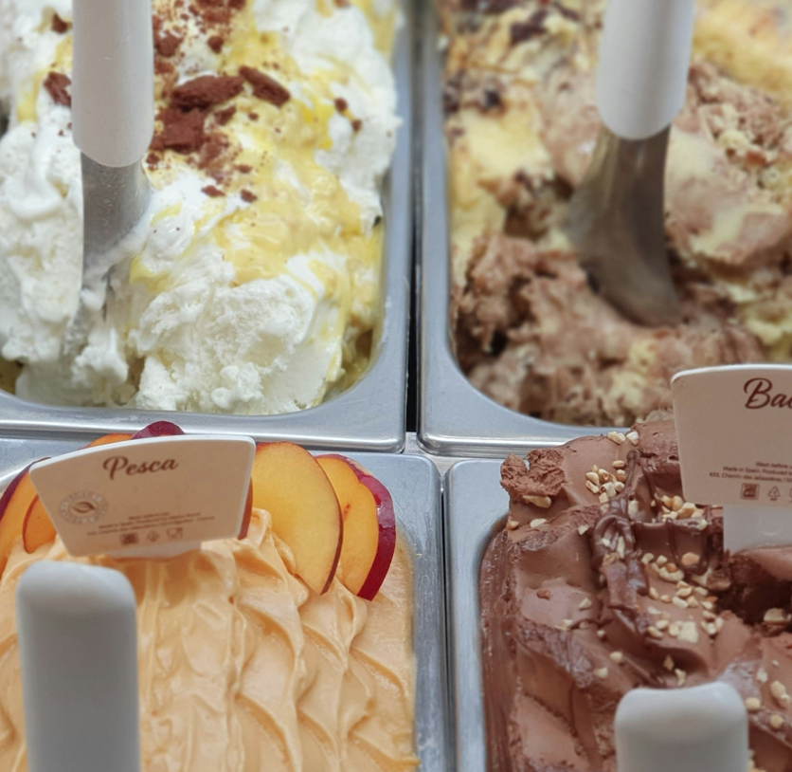

Semantic Game (truth in a model)
Hybrid Logic
📘 RF. Games for Hybrid Logic. WoLLIC 2021
📕 RF. Games for Hybrid Logic. Journal of Logic and Computation, (to appear).
lift
Choice Logics
Provability Game
(validity)
📙 RF and Michael Bernreiter. Truth and Preferences - A Game Approach for Qualitative Choice Logic. JELIA 2023.
📗 RF and Michael Bernreiter. Validity in Choice Logics. WoLLIC 2023.
extract
Analytic Calculus
General Framework
Notes:
5min

